Slide 1

Music trends per Billboard Hot 100
Team Members:
Team Leader: Hayley Jellison @hayleyjellison
Git Master: Chris Nguyen @c-l-nguyen
Data Analyst: Josefina Blanchard @josefina-blanchard
Data Analyst: Amy Dach @amydach
Repo: hayleys-cosmic-songs https://github.com/c-l-nguyen/hayleys-cosmic-songs/tree/master

Slide 2
Motivation and Summary Slide
Our team tracked music data from the US Billboard Hot 100 songs (singles) list from 1958-2017.
We aimed to uncover what genre of songs were most popular by decade and how they have changed
We explored how popularity of songs with various qualities, such as "danceability" scores based on analysis from Spotify, have changed over decades.
We also did an in-depth analysis of song qualities using data collected from the Spotify API from 2000-2017.
A few questions we considered in our analysis:
What genres were the most popular in the Billboard Hot 100 List? How has that changed over the years? Decades?
How do we define "popularity" of a song?
Which artists appear the most in the list?
Which song(s) appear the most in the list?
How have certain qualities of the song (such as tempo, beat, "danceability") changed over the years within the Hot 100 list?
Are there any qualities that are distinct about the most popular songs within a decade?

Slide 3
Data Sources/Cleanup/Analysis
Data Sources – Selected because it limited the scope, spanned multiple decades and focused on US
Billboard Hot weekly charts from data.world
Billboard Hot-100 Songs 2000-2018 w/ Spotify Data + Lyrics from data.world
APIs Used
Spotify Developer Web API
API Wrappers
Spotipy - a thin client library for the Spotify Web API
Data Cleanup
Billboard Hot 100 was matched to Spotify to gain additional metrics about each song.
Some Billboard records didn’t match in Spotify and Spotify genres weren’t clean
Spotify API rate limit was determined dynamically
Data Analysis
Evaluated all Spotify metrics to determine which were most correlated.
Observed trends by genre over time.

Slide 4
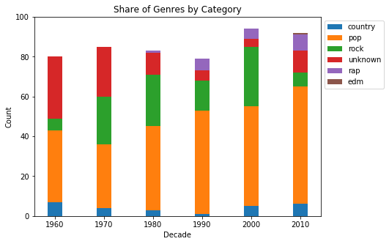
The pop genre has grown to dominate the top 100 songs of the decade, with a decline in rock music.
Spotify genre is defined by the artist rather than the individual song.

Slide 5
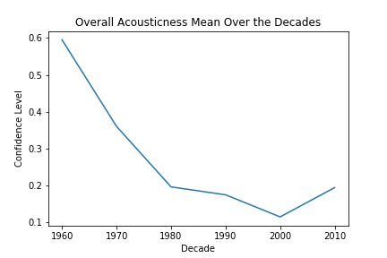
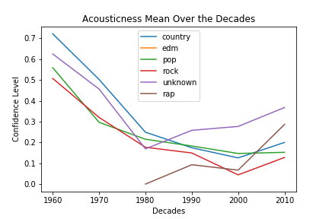
The acousticness mean has declined significantly over the decades, but has increased starting in 2000 in all genres except pop.
Note: Spotify describes acousticness as a confidence measure from 0.0 to 1.0 of whether the track is acoustic.

Slide 6
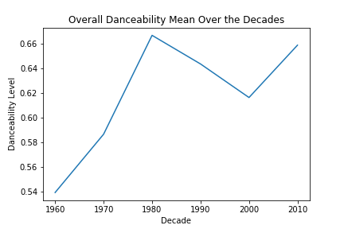
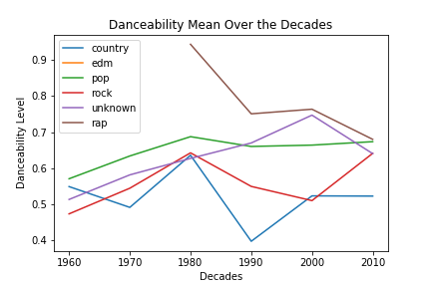
The danceability mean has declined starting in the 90s driven by rap and country. It is making a comeback in 2000s driven by rock music.
Note: Spotify describes danceability as how suitable a track is for dancing based on a combination of musical elements including tempo, rhythm stability, beat strength, and overall regularity. Score is from 0 to 1.

Slide 7
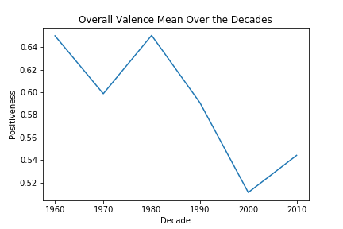
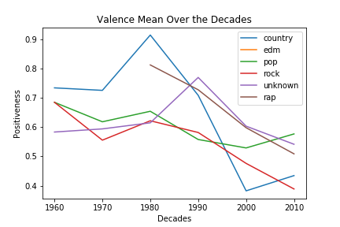
Valance declined substantially over the decades, but increased starting in 2000s driven by country and pop
Note: Spotify describes valance as a measure from 0.0 to 1.0 describing the musical positiveness conveyed by a track. Tracks with high valence sound more positive (e.g. happy, cheerful, euphoric), while tracks with low valence sound more negative (e.g. sad, depressed, angry).

Slide 8
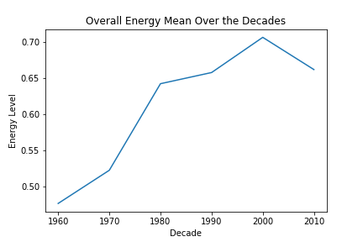
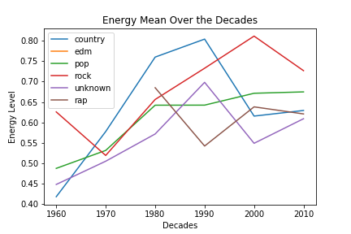
The energy level of songs increased across the decades thru 2000’s, but has since declined driven by rock music.
Note: Spotify describes energy as a measure from 0.0 to 1.0 and represents a perceptual measure of intensity and activity. Typically, energetic tracks feel fast, loud, and noisy. For example, death metal has high energy, while a Bach prelude scores low on the scale. Perceptual features contributing to this attribute include dynamic range, perceived loudness, timbre, onset rate, and general entropy.

Slide 9
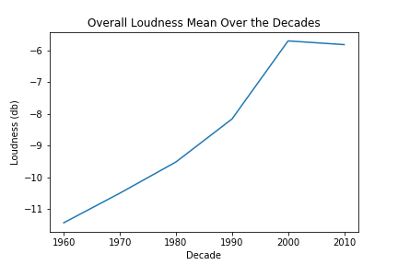
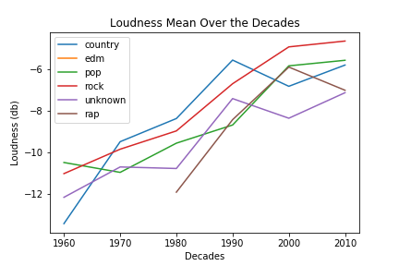
Loudness of songs has gradually increased across all genres over the decades, but began to stabilize in the 2000’s.
Note: Spotify describes loudness as overall loudness of a track in decibels (dB). Loudness values are averaged across the entire track and are useful for comparing relative loudness of tracks. Loudness is the quality of a sound that is the primary psychological correlate of physical strength (amplitude). Values typical range between -60 and 0 db.

Slide 10
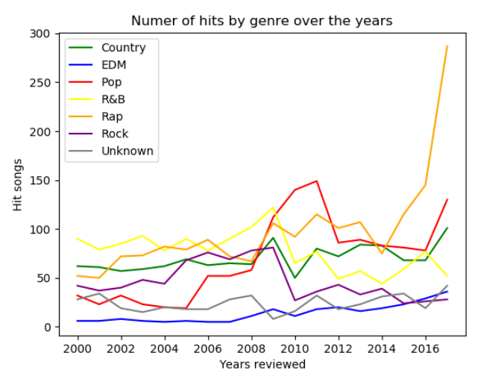
Popularity of rap has spiked dramatically since 2014
Spotify genre is defined by the artist rather than the individual song.

Slide 11
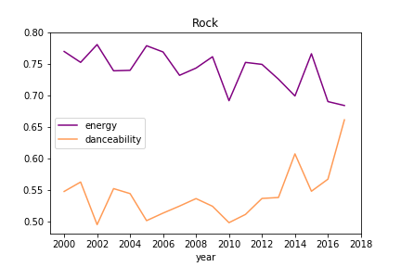
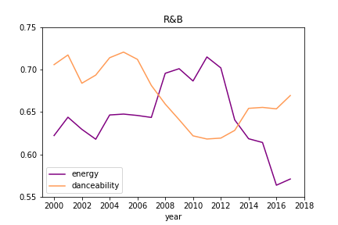
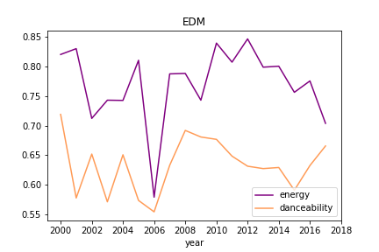
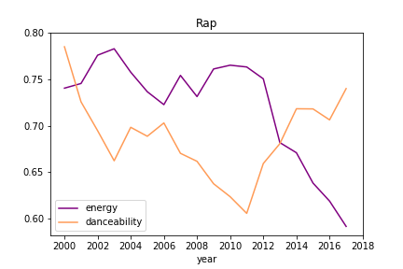
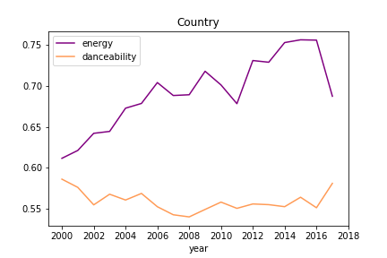
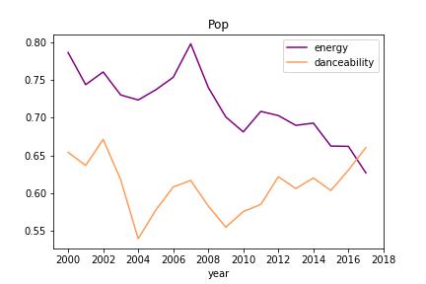
Danceability and energy appear to be negatively correlated. Rap and R&B energy have dropped substantially since 2011.

Slide 12
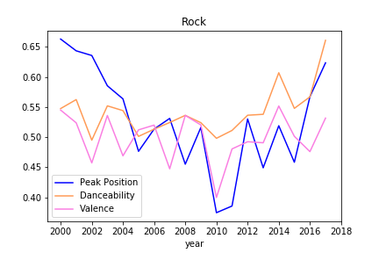
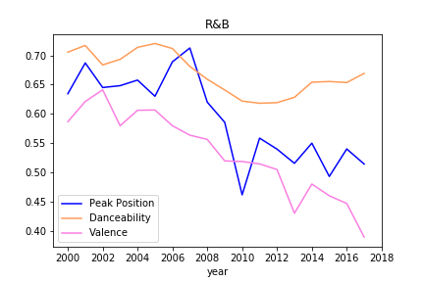
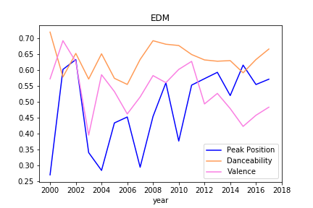
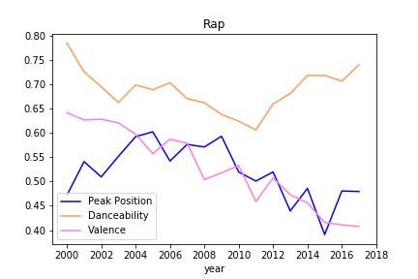
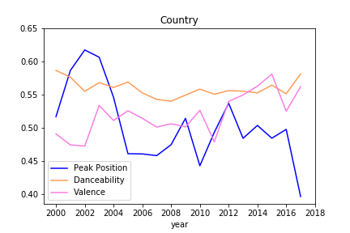
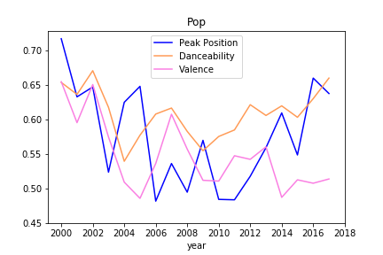
Pop, Rock and EDM songs’ peak position/danceability have increased the past several years after a low point in 2008-2010. Rap/R&B peak position/valence have declined steadily since 2000, although danceability has remained steady.

Slide 13
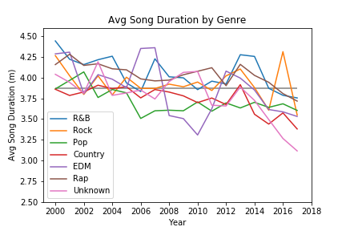
Since 2000, song duration has declined across all genres.

Slide 14
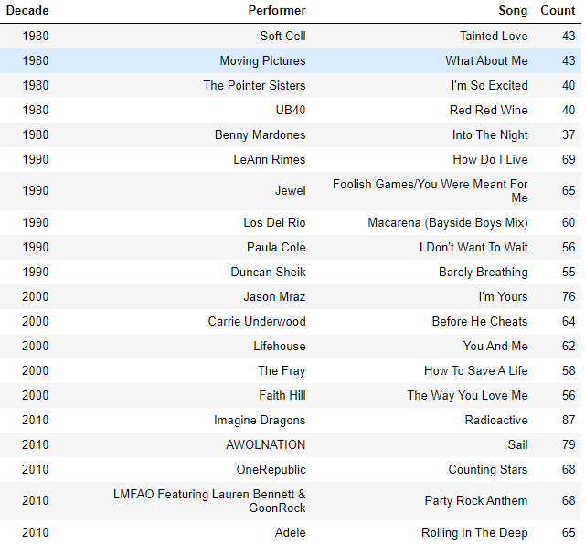
Top Songs/Artists by Decade

Slide 15
Summary of Results
Pop songs have grown to dominate the top 100 at the expense of Rock over the decades
Rap is still small at 2017, so impact is small.
Acoustic songs have declined over the decades, but are ramping in Pop in 2000s.
Valance declined substantially over the decades, but increased in 2000s driven by country and pop
Danceability has been making a come back since 2000.
Energy level/Loudness ramped over the decades, but has been declining since 2000.
Pop, Rock and EDM song peak position/danceability have increased over the past several years.
Rap/R&B peak position/valence have declined steadily since 2000, although danceability has remained steady.
Popularity of rap has spiked dramatically since 2014.
Since 2000, song duration has declined across all genres.

Slide 16
Issues/Next Steps
Issues:
Inconsistent availability of explicit rating data, so we skipped it.
Low mix of rap in top 100 until late 2000s, so impact on explicit ratings is immaterial.
Considered pulling local musicians’ song data, but no sources.
Global data was available in some sources but not others.
Spotify data pull limits were a factor.
Next Steps:
Compare to other sources.
iTunes
Rapid API: 30,000 radio stations and music charts
Streams daily updated urls, classified by music genre and countries (over 130 countries and 167 music genres)
Last.fm
Builds a detailed profile of user’s musical taste by recording details of the tracks listened from internet radio stations, users’ computers, or portable music devices. Information is transferred to Last.fm’s database either via the music player itself (Spotify, Deezer, Tidal, etc.) or via a plug-in installed into users’ music player.

